Slide 1
Euro Trip
An EU holiday helper
Adam Loney - 1910136

Slide 2
Purpose
The purpose of this app is to be a tool used to help you on a holiday throughout the EU. A one stop tool for your trip.
Not all EU countries have the same levels of VAT – causing different “spending power” in different countries, despite the same economic sphere.
Not all EU countries use Euros – it can be a bit bewildering going from one country to another and needing to change currencies.
The EU has over 20 official languages, good luck learning all of that on your trip.

Slide 3
Functionality
Currency conversion – convert from a chosen currency to either Euros or the currency of a country within the EU with their own currency.
Show VAT – Whilst not a huge difference between countries, it’s still nice to see how far your Euros will go in different countries.
Translate Languages – Translate languages as you need and as you enter unfamiliar countries.

Slide 4
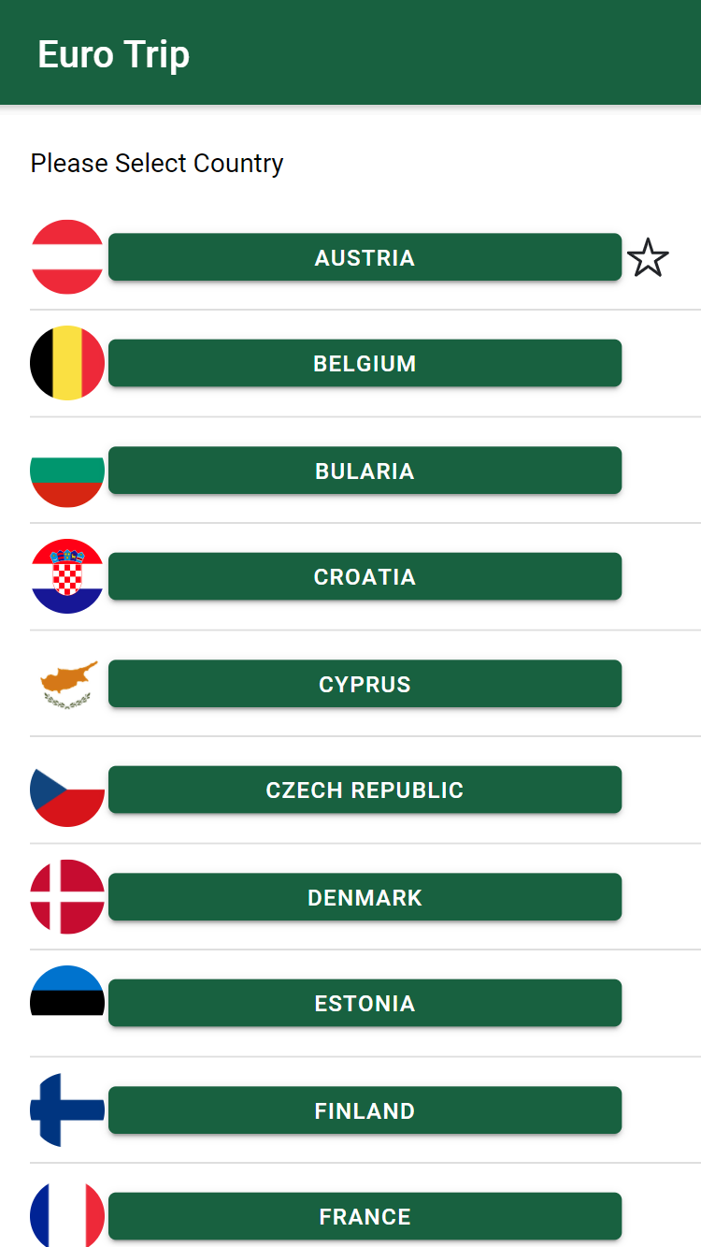
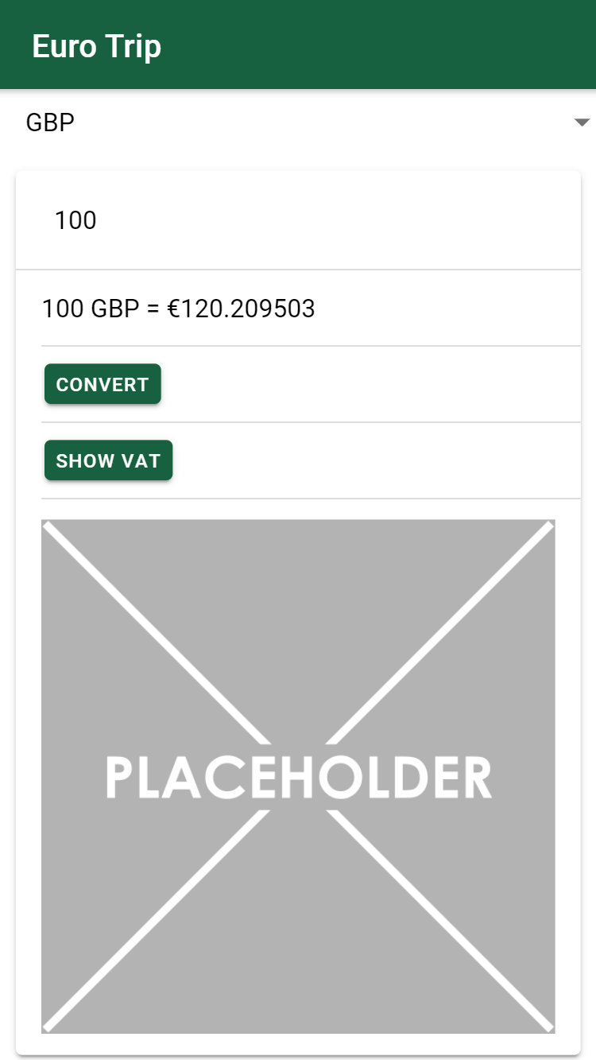
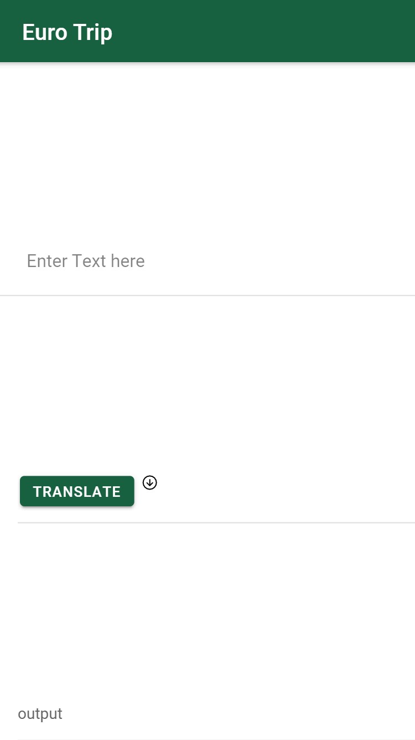
Wireframes

